Slide 1

by PRAVEEN REDDY Y Roll No : 214G5A3203
AI-ML Virtual Internship
AI-ML Virtual Internship
Department of Computer Science and Engineering (Data Science)
Srinivasa Ramanujan Institute of Technology
Autonomous
Rotarypuram Village, B K Samudram Mandal, Ananthapuramu – 515701.
2022-2023
3203
Dept. of Computer Science and Engineering(Data Science)
Srinivasa Ramanujan Institute Of Technology
1

Slide 2

AI-ML Virtual Internship
Contents
Introduction
Modules
Modules Explanation
Conclusion
References
3203
Dept. of Computer Science and Engineering(Data Science)
Srinivasa Ramanujan Institute of Technology
2

Slide 3
AI-ML Virtual Internship
Introduction
AWS Academy Cloud Foundations
Offers a comprehensive overview of cloud principles, AWS core services, security, architecture, pricing, and support.
Empowers learners with a foundational understanding of cloud technology, regardless of specific technical roles.
AWS Academy Machine Learning Foundation
Presents fundamental AI and machine learning concepts and terminology.
Provides hands-on experience in labeling, building, training, and deploying custom machine learning models.
From Eduskills Foundation, AICTE launches a Virtual Internship on AI-ML.
The main aim of this is to gain insights into cutting-edge cloud and AI technologies.
3203
Dept. of Computer Science and Engineering(Data Science)
Srinivasa Ramanujan Institute of Technology
3

Slide 4
AI-ML Virtual Internship
Modules
Cloud Concepts Overview
AWS Cloud Security
Compute
Storage
Cloud Architecture
Introducing Machine Learning
Introducing Forecasting
Implementing a Machine Learning pipeline with Amazon SageMaker
Introducing Natural Language Processing
3203
Dept. of Computer Science and Engineering(Data Science)
Srinivasa Ramanujan Institute of Technology
4

Slide 5
AI-ML Virtual Internship
Cloud Concepts Overview
Cloud Computing : Cloud computing is the delivery of computing services (such as storage, processing power, databases, networking, software, and more) over the internet. Users can access these resources on-demand, without the need for physical infrastructure.
Service Models: Cloud computing offers various service models that define the level of control and responsibility a user has over the cloud resources. The common service models are:
Infrastructure as a Service (IaaS)
Platform as a Service (PaaS)
Software as a Service (SaaS)
3203
Dept. of Computer Science and Engineering(Data Science)
Srinivasa Ramanujan Institute of Technology
5

Slide 6
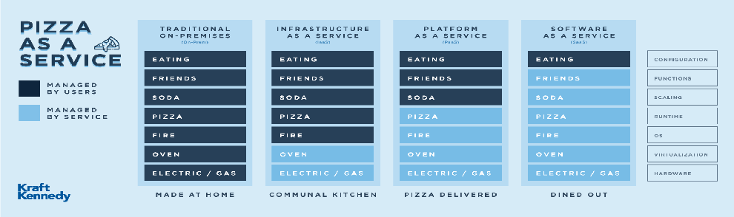
AI-ML Virtual Internship
Cloud Concepts Overview
Infrastructure as a Service (IaaS): Provides virtualized computing resources over the internet. Users can rent virtual machines, storage, and networking components.
Platform as a Service (PaaS): Offers a platform that includes hardware and software tools for application development, testing, and deployment.
Software as a Service (SaaS): Delivers software applications over the internet, eliminating the need for installation and maintenance on the user's end.
3203
Dept. of Computer Science and Engineering(Data Science)
Srinivasa Ramanujan Institute of Technology
6

Slide 7
AI-ML Virtual Internship
Cloud Concepts Overview Contd..
Cloud computing deployment models
Public Cloud
Hybrid Cloud
On-premse (Private Cloud)
What is AWS :
AWS is a secure cloud platform that offers a broad set of global cloud-based products called services that are designed to work together.
There are three ways to interact with AWS services:
AWS Management Console - Graphical interface
Command Line Interface (CLI) - Access via discrete commands or scripts
Software Development Kits (SDK) - Access directly from code
3203
Dept. of Computer Science and Engineering(Data Science)
Srinivasa Ramanujan Institute of Technology
7

Slide 8
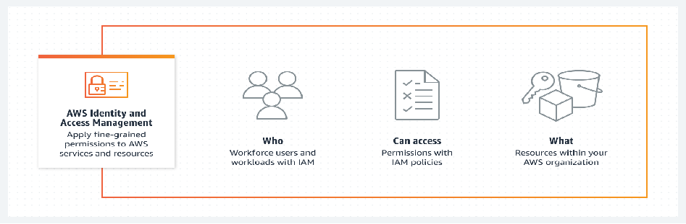
AI-ML Virtual Internship
AWS Cloud Security
Shared Responsibility Model: AWS follows a shared responsibility model, which means that both AWS and its customers have responsibilities for security. AWS is responsible for the security "of" the cloud (such as the physical infrastructure and global network), while customers are responsible for security "in" the cloud (such as securing their data, applications, and configurations).
Identity and Access Management (IAM): IAM allows you to manage users, roles, and permissions. It enables fine-grained control over who can access your resources and what actions they can perform. Multi-factor authentication (MFA) is strongly recommended for enhancing account security.
3203
Dept. of Computer Science and Engineering(Data Science)
Srinivasa Ramanujan Institute of Technology
8

Slide 9
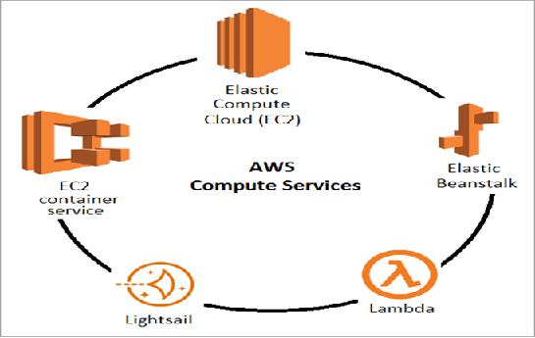
AI-ML Virtual Internship
Compute
Docker is a software platform that enables you to build, test, and deploy applications quickly.
It is used to run the containers.
Amazon Pricing Models
On-Demand Instances
Spot Instance
Reserved Instances
Scheduled Reserved Instances
3203
Dept. of Computer Science and Engineering(Data Science)
Srinivasa Ramanujan Institute of Technology
9

Slide 10
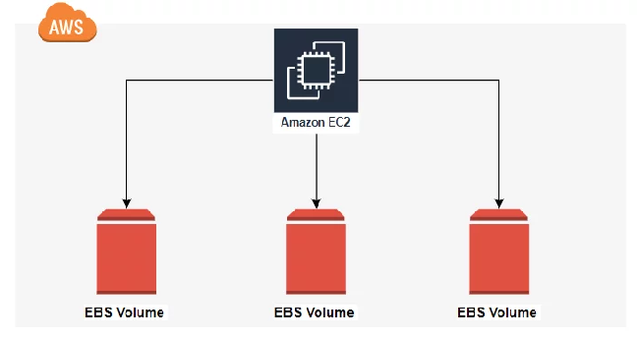
AI-ML Virtual Internship
Storage
Amazon Elastic Block Store (EBS)
Amazon Elastic Block Store (EBS) is an easy to use, high performance block storage service designed for use with Amazon Elastic Compute Cloud (EC2) for both throughput and transaction intensive workloads at any scale. With block storage, files are split into evenly sized blocks of data, each with its own address but with no additional information to provide more context for what that block of data is.
Offers Block Level Storage
HDD and SDD available
3203
Dept. of Computer Science and Engineering(Data Science)
Srinivasa Ramanujan Institute of Technology
10

Slide 11
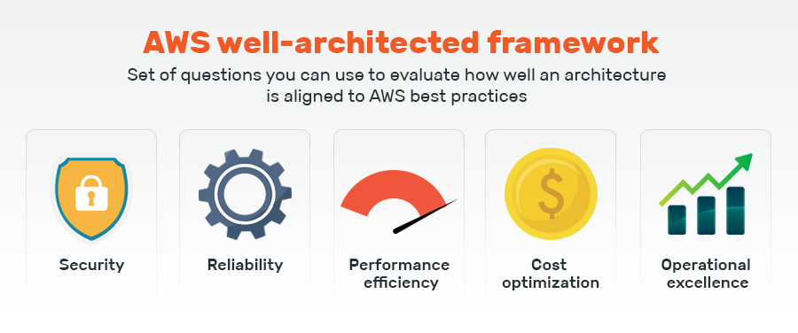
AI-ML Virtual Internship
Cloud Architecture
AWS Well-Architected Framework
The AWS Well-Architected Framework is organized into five pillars
Security
Reliability
Performance Efficiency
Cost Optimization
Operational Excellence
3203
Dept. of Computer Science and Engineering(Data Science)
Srinivasa Ramanujan Institute of Technology
11

Slide 12
AI-ML Virtual Internship
Introducing Machine Learning
Machine Learning : Machine learning is a subset of AI, which is a broad branch of computer science for building machines that can do human tasks. Deep learning itself a subdomain of machine learning.
Machine learning is the scientific study of algorithms and statistical models to perform a task by using inference instead of instructions
Types of Machine Learning
Supervised learning, where a model uses known inputs and outputs to generalize future outputs.
Unsupervised learning, where the model doesn’t know inputs or outputs it finds patterns in the data without help.
Reinforcement learning, where the model interacts with its environment and learns to take actions that maximize rewards.
3203
Dept. of Computer Science and Engineering(Data Science)
Srinivasa Ramanujan Institute of Technology
12

Slide 13
AI-ML Virtual Internship
Introducing Forecasting
Overview of forecasting
Forecasting is an important area of machine learning. It is like predicting future that are based on historical data.
Applications :
Marketing applications, such as sales forecasting or demand projections.
Inventory management systems to anticipate required inventory levels. Often, this type of forecast includes information about delivery times.
Energy consumption to determine when and where energy is needed.
Weather forecasting systems for governments, and commercial applications such as agriculture
Using Amazon Forecast
Import historical and Related data
Amazon Forecast inspects the data, identifies key data, and selects an appropriate algorithm.
It uses the algorithm to train and optimize a custom model and produce a predictor.
3203
Dept. of Computer Science and Engineering(Data Science)
Srinivasa Ramanujan Institute of Technology
13

Slide 14
AI-ML Virtual Internship
Implementing a Machine Learning pipeline with Amazon SageMaker
Creating a machine learning pipeline using Amazon SageMaker involves a series of steps to preprocess data, build and train models, and deploy them for inference. Here's an overview of implementing a machine learning pipeline with Amazon SageMaker:
Before creating a pipeline, you need to prepare and preprocess your data:
Data Collection: Gather the dataset you'll be working with. This could be structured data from databases or unstructured data like images and text.
Data Cleaning and Preprocessing: Clean the data by handling missing values, outliers, and inconsistencies. Preprocess the data by scaling, normalizing, or encoding categorical variables as needed.
Feature Engineering: Create new features or transform existing ones to improve model performance.
3203
Dept. of Computer Science and Engineering(Data Science)
Srinivasa Ramanujan Institute of Technology
14

Slide 15
AI-ML Virtual Internship
Introducing Natural Language Processing
Natural Language Processing (NLP) is a branch of artificial intelligence (AI) that focuses on the interaction between computers and human language. It involves enabling computers to understand, interpret, and generate human language in a way that is both meaningful and useful.
NLP encompasses a wide range of tasks and techniques, including:
Tokenization: Breaking down a text into smaller units called tokens, which could be words, phrases, or even characters.
Language Generation: NLP enables computers to generate human-like language, which finds applications in chatbots, text summarization, and content creation.
Speech Recognition: NLP algorithms convert spoken language into text, enabling voice assistants and transcription services
Question Answering: NLP models can process questions and provide relevant answers based on large amounts of textual information.
3203
Dept. of Computer Science and Engineering(Data Science)
Srinivasa Ramanujan Institute of Technology
15

Slide 16
AI-ML Virtual Internship
Conclusion
Our journey through cloud concepts, artificial intelligence, and machine learning has been truly eye-opening. We now hold the keys to unlocking innovation. "We've learned a lot about cloud, AI, and machine learning. These tools let us use computers in amazing new ways. We're just beginning, and with these tools, we can do many great things in the future. It's going to be an exciting trip.We're ready to use them to make cool stuff and change the future. This knowledge lets us innovate, making computers smarter and more helpful.
3203
Dept. of Computer Science and Engineering(Data Science)
Srinivasa Ramanujan Institute of Technology
16

Slide 17
AI-ML Virtual Internship
References:
[1] https://www.awsacademy.com/vforcesite/LMS_Login
[2] https://internship.aicte-india.org
3203
Dept. of Computer Science and Engineering(Data Science)
Srinivasa Ramanujan Institute of Technology
17

Slide 18
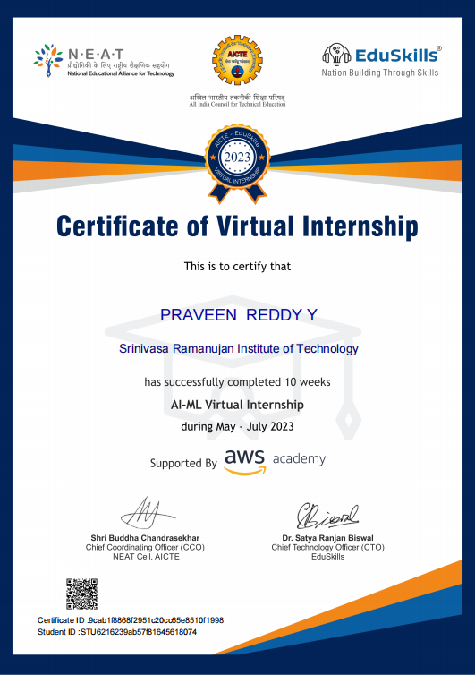
AI-ML Virtual Internship
Internship Certificate:
3203
Dept. of Computer Science and Engineering(Data Science)
Srinivasa Ramanujan Institute of Technology
18

Slide 19
Cyber Security Virtual Internship
Thank You...!
3203
Dept. of Computer Science and Engineering(Data Science)
Srinivasa Ramanujan Institute of Technology
19

